Slide 1
3

Slide 2
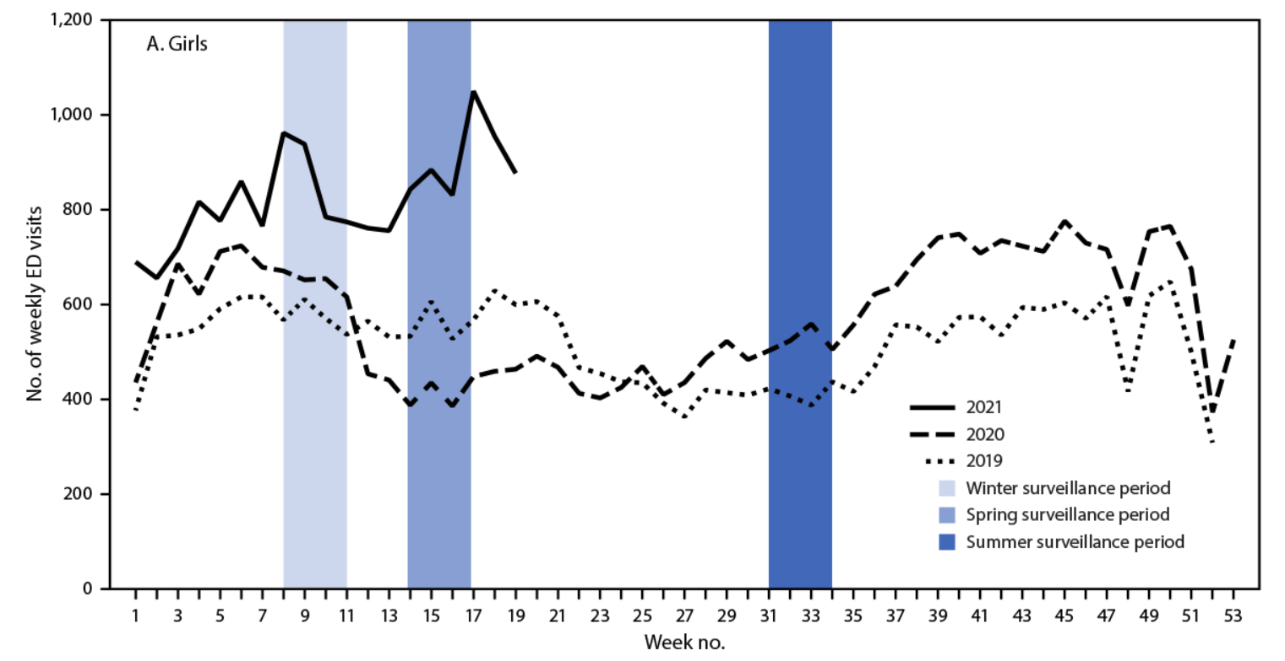
Suicide Attempts in Teens

Slide 3
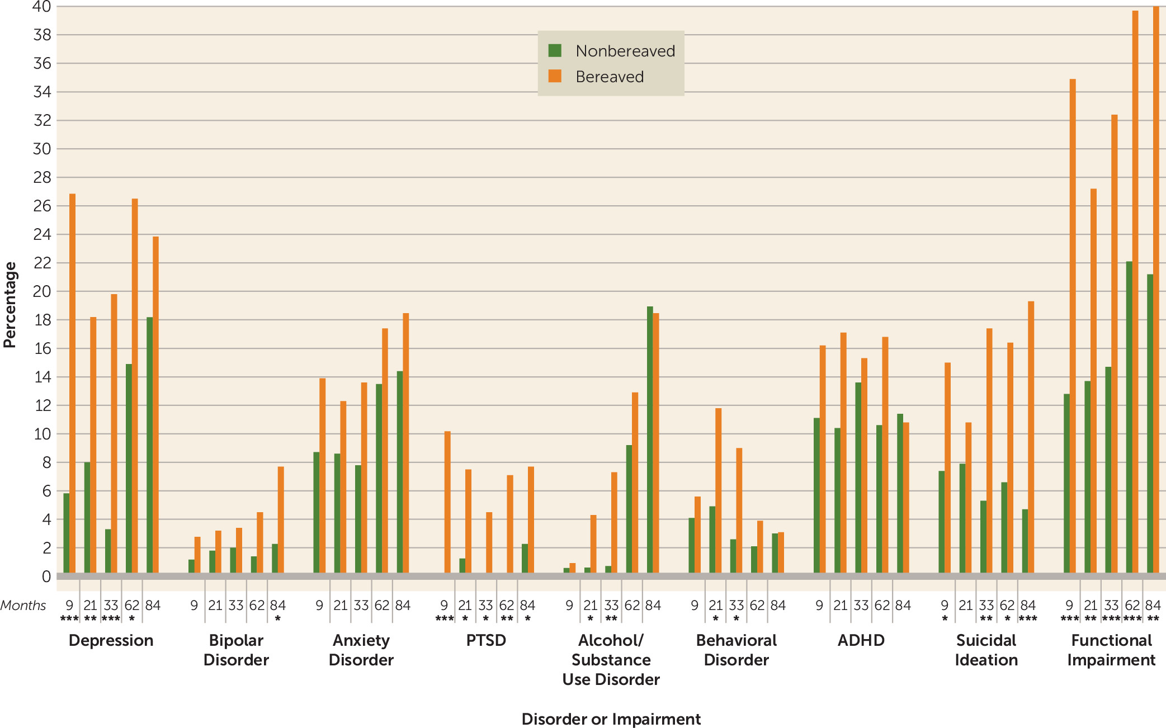
Impact of a Child Losing
a Parent or Sibling
Notes:
https://ajp.psychiatryonline.org/doi/full/10.1176/appi.ajp.2018.17070792?rfr_dat=cr_pub%3Dpubmed&url_ver=Z39.88-2003&rfr_id=ori%3Arid%3Acrossref.org

Slide 4
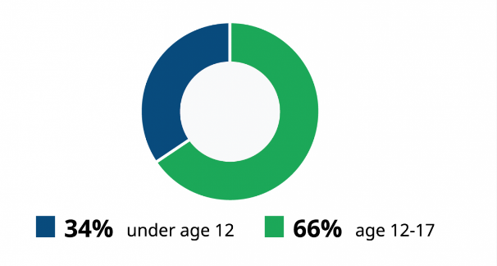
Victims of Sexual Violence
Under 18 years old
1 in 9 girls
1 in 53 boys

Slide 5
We hope for miracle solutions to save our kids, but unfortunately those aren’t coming.
For many kids, the only choice is to build resiliency skills and do their best to face the realities ahead of them.

Slide 6
Where Promises Begin
Building 100 Years of Resiliency

Slide 7
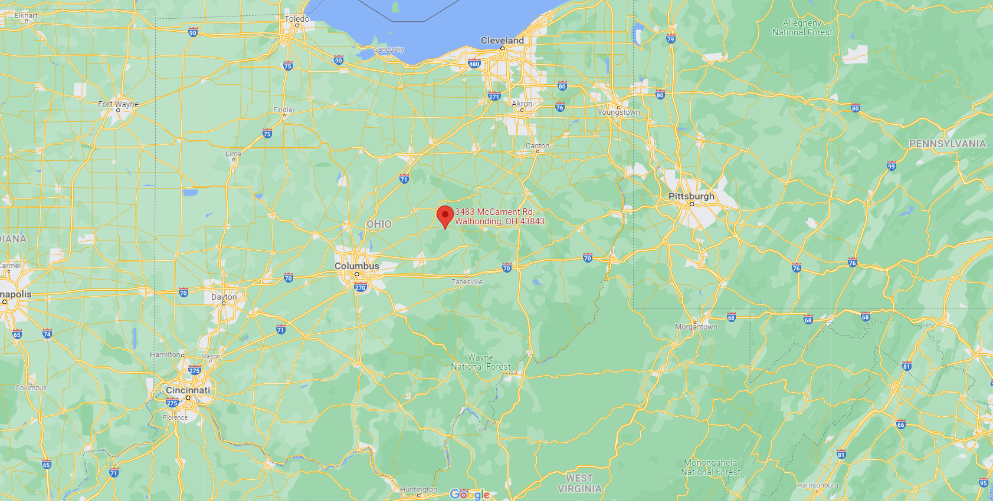
Cleveland
2-hour drive or less
3-hour drive or less
Pittsburgh
Columbus
Cincinnati
Location: Walhonding, Ohio

Slide 8
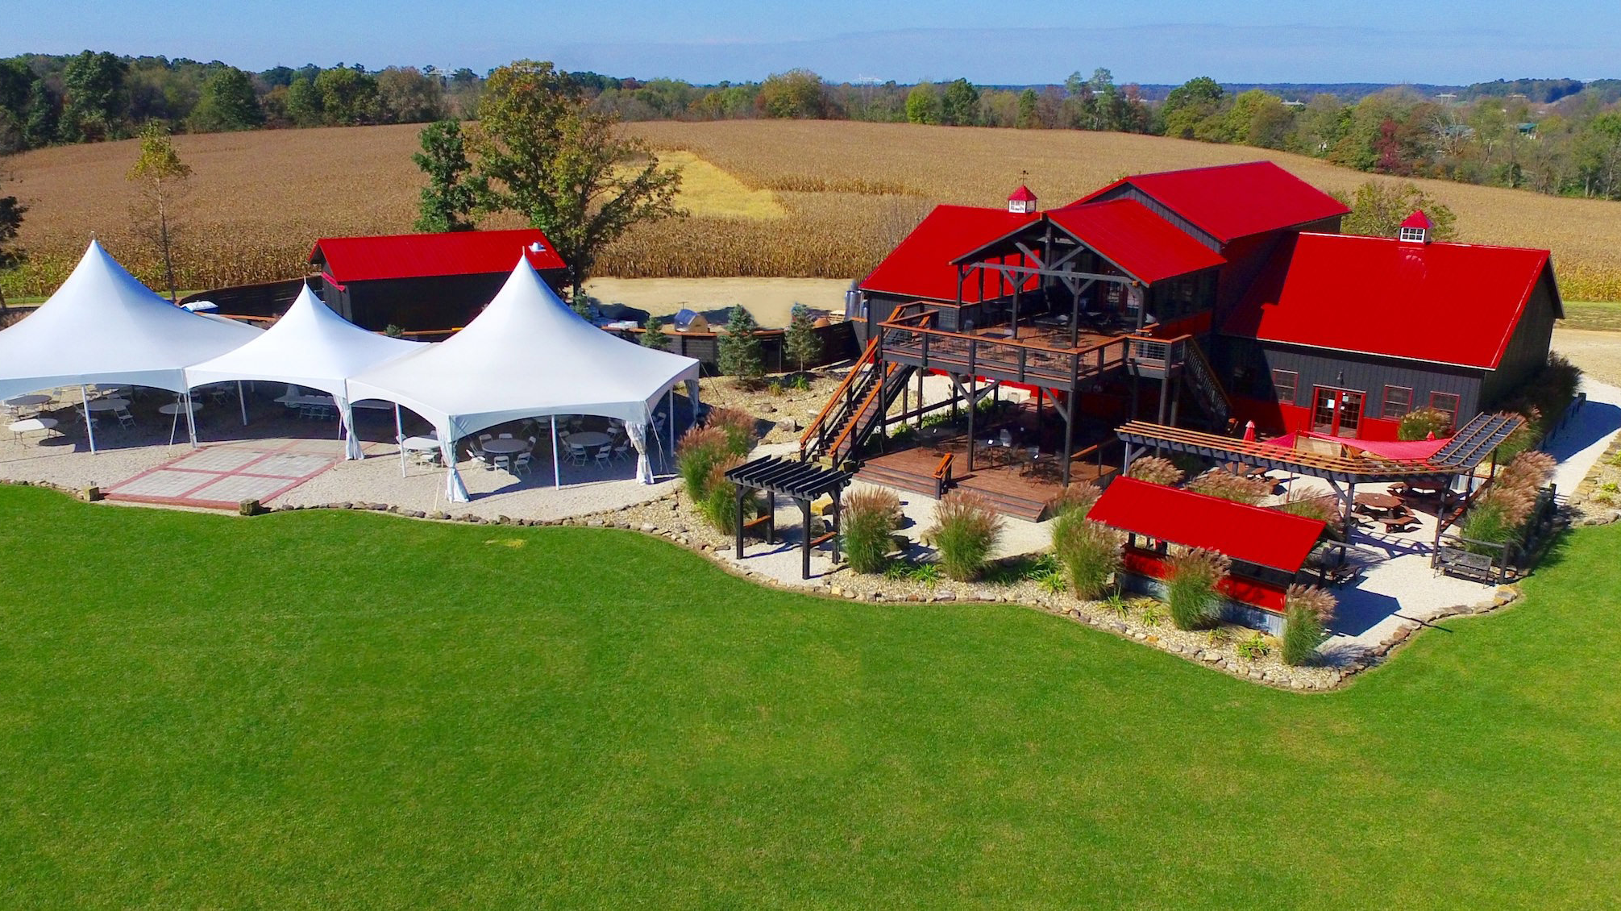
Currently a Winery, Event Venue & Luxury Cabin Business

Slide 9
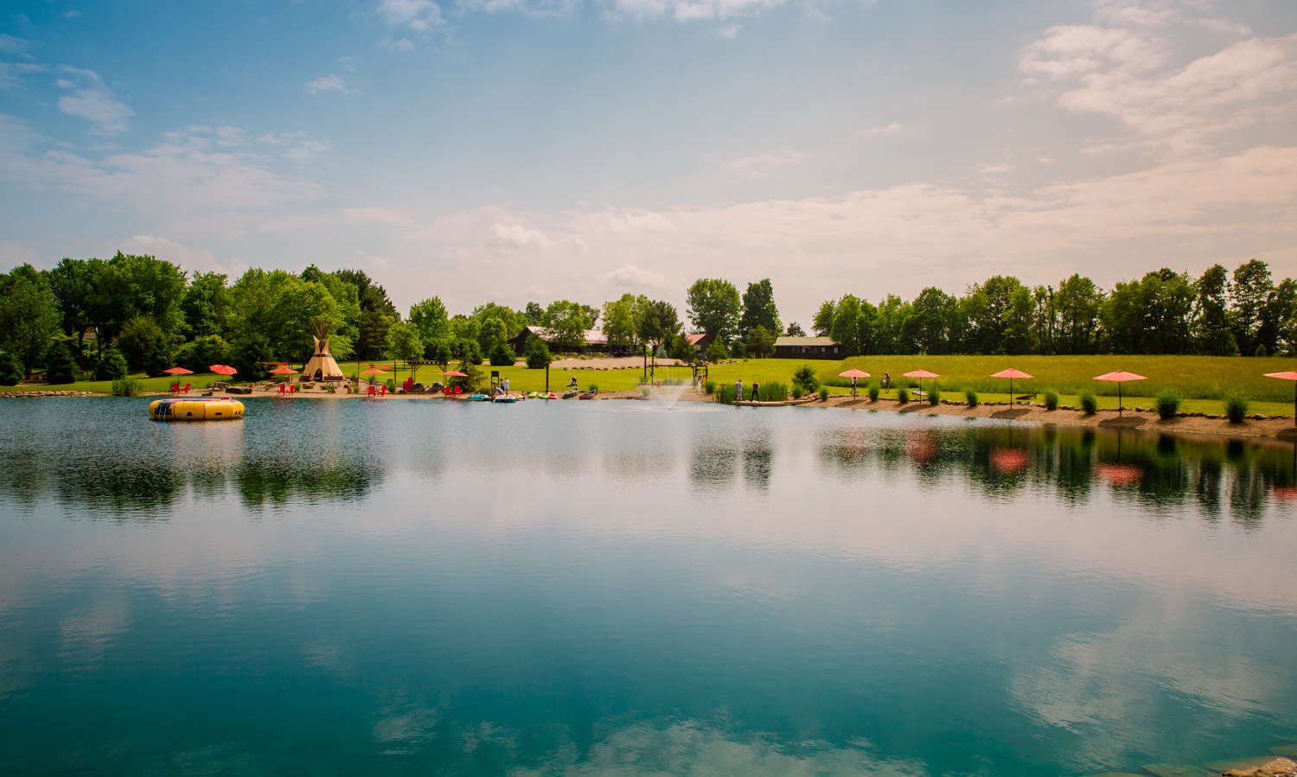
Turning into to Youth Summer Camp &
Family Bereavement Retreat Center

Slide 10
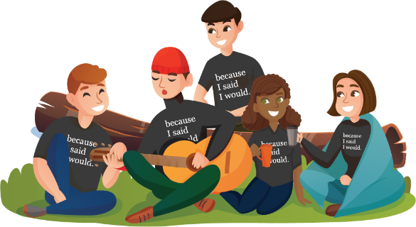
Programming & Mission
Social Emotional Learning – Mental Health – Character Development

Slide 11
r

Slide 12
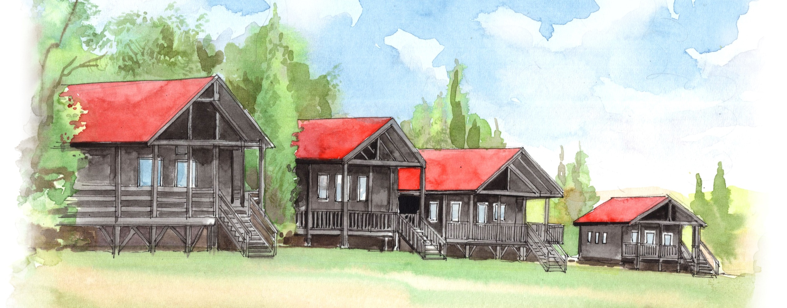
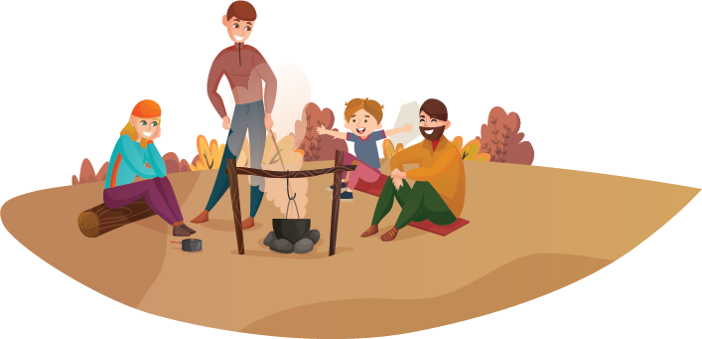
New Cabins for 100 Youth Campers

Slide 13
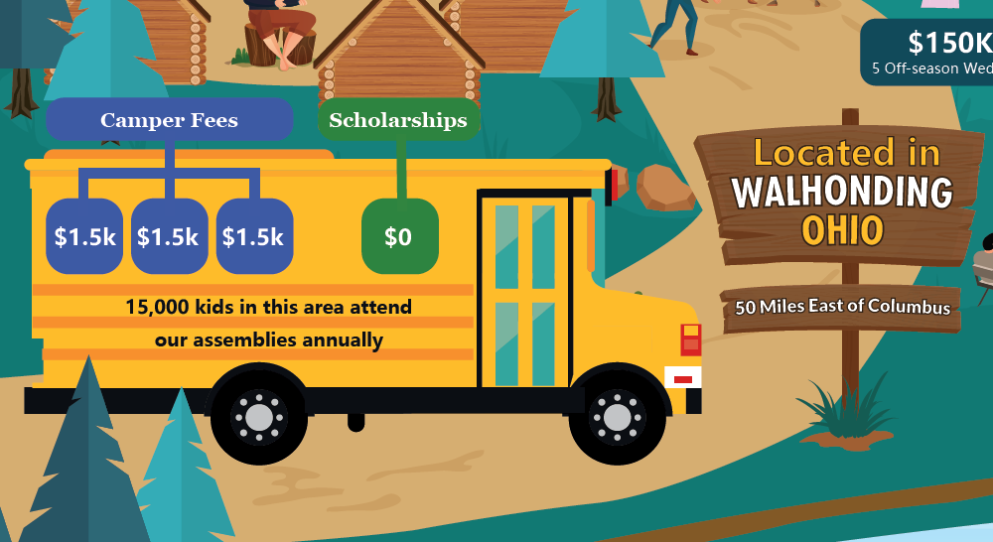
Camper Fees
Scholarships
Campers head back & start
because I said I would Chapters
at their schools.

Slide 15
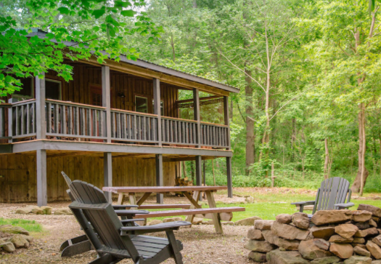
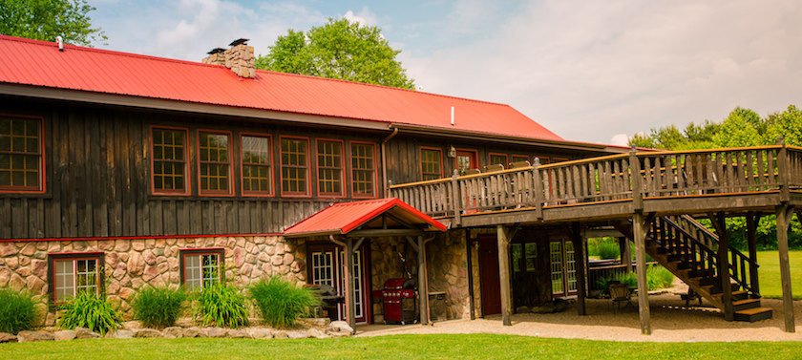
Existing Cabins for Families In Bereavement
1,000 sq. ft.
1,000 sq. ft.
1,000 sq. ft.
1,500 sq. ft.
8,500 sq. ft.

Slide 16
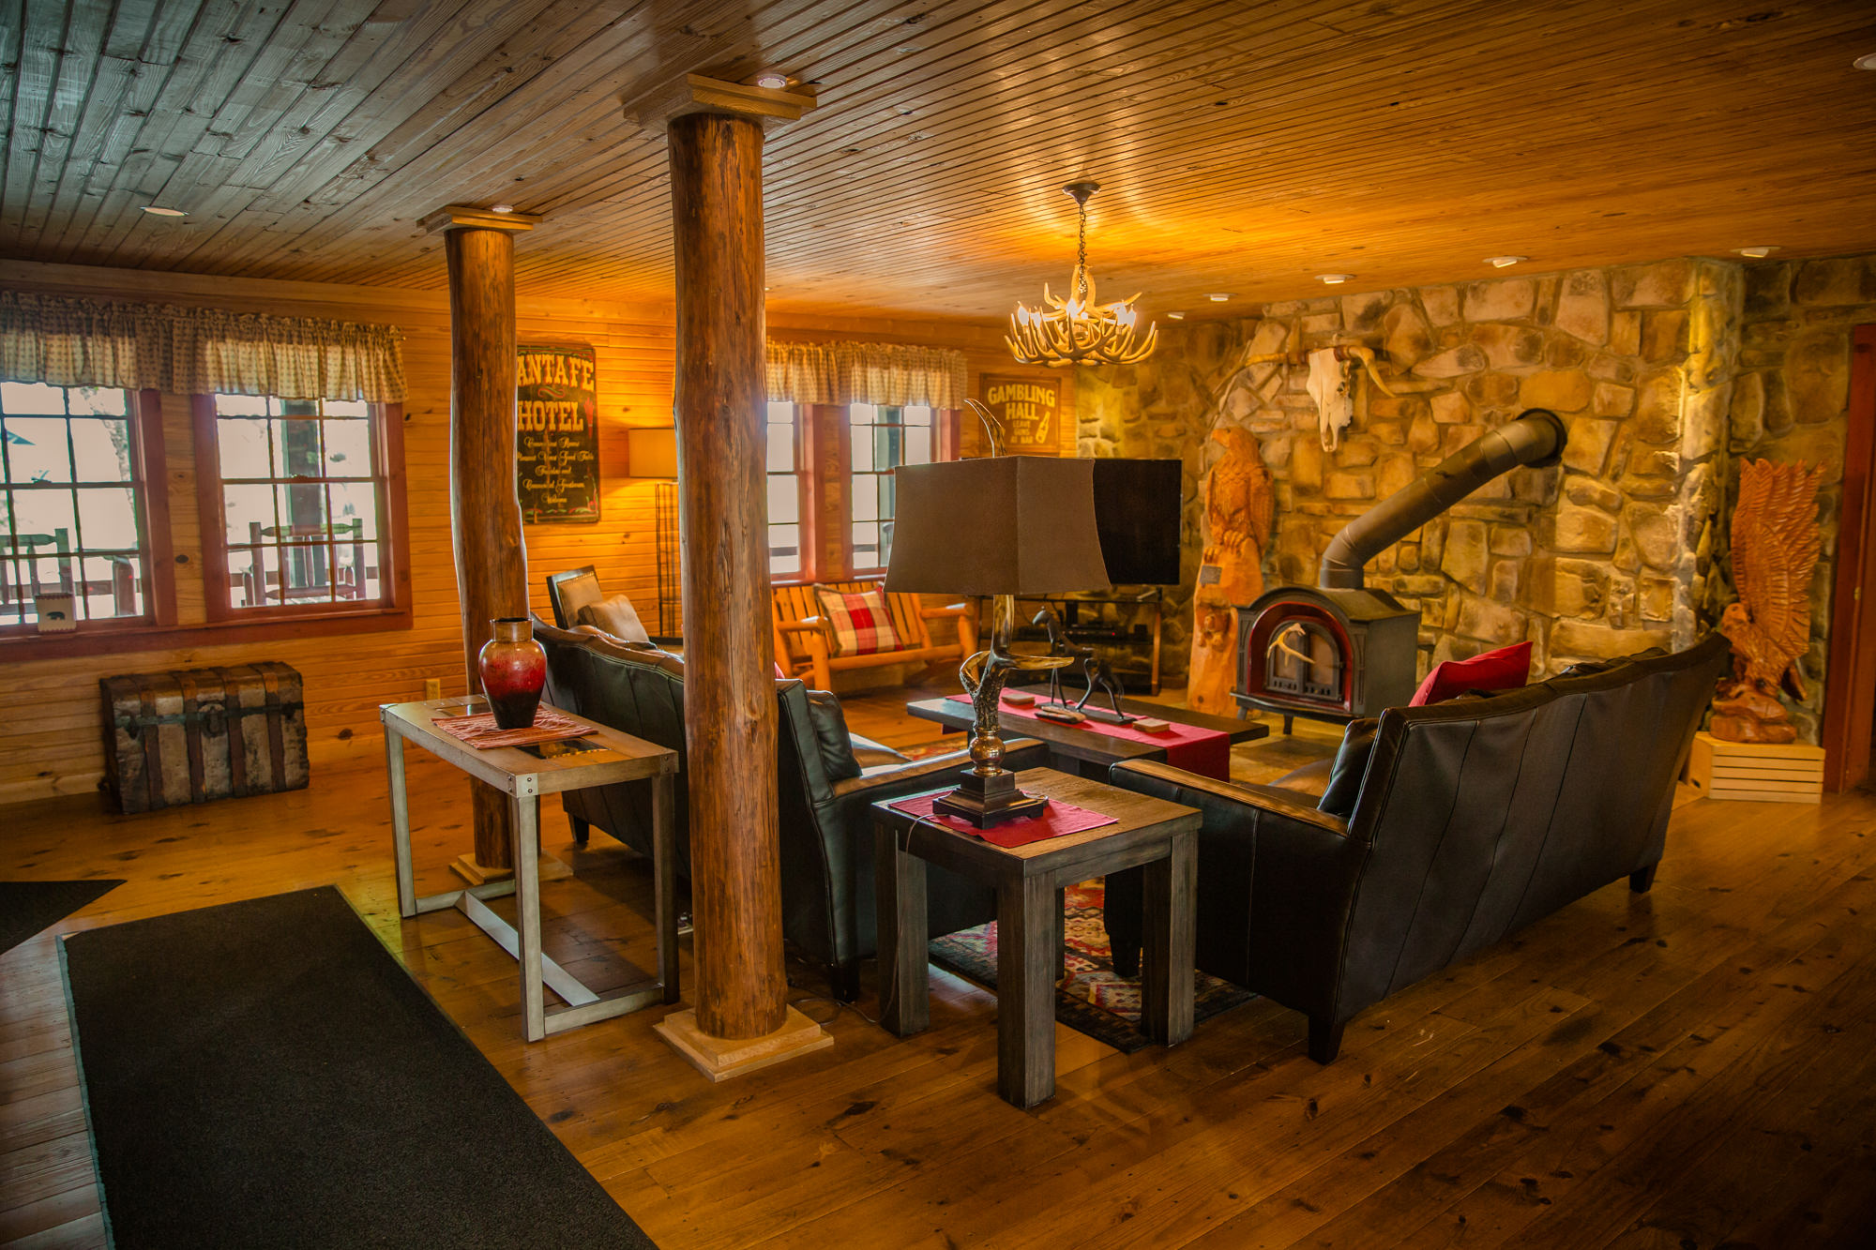
Main Lodge
Largest cabin has 7 bedrooms, 7.5 baths,
3 kitchens, sauna & hot tub

Slide 17
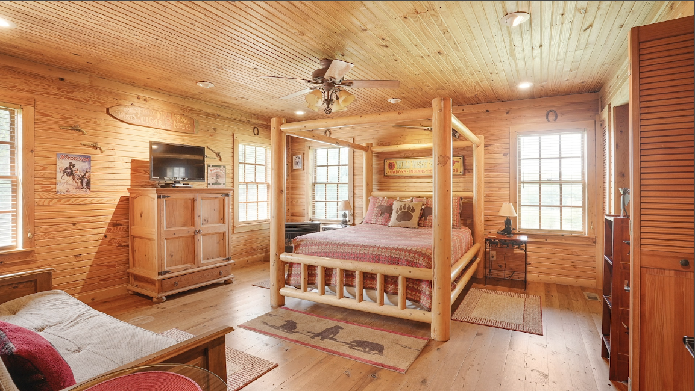
Luxury accommodations for family bereavement retreats

Slide 18
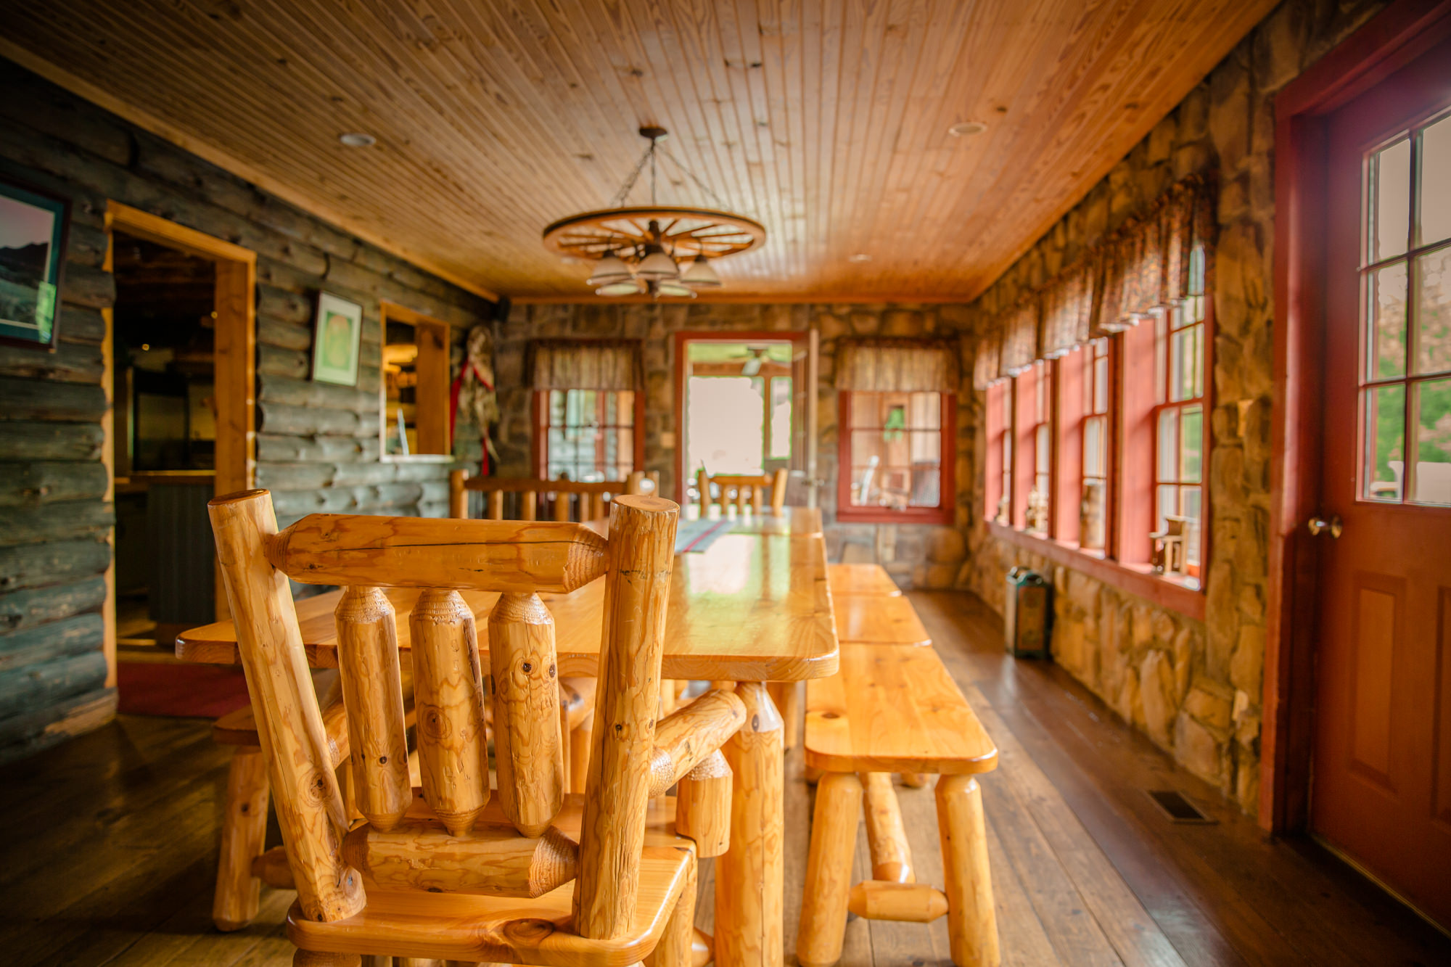
A place to reset and learn resiliency skills

Slide 19
Naming Opportunities
Fundraising.becauseisaidiwould.org/camp
2022
Goal
The First Location of Many Future Camps
Be the Change
92-acres to build on
40 different naming opportunities
Ranging from $1k - $1.5M
$5.8M
Fundraising
Campaign

Slide 20
Be a Fundraising Leader!
Fundraising.becauseisaidiwould.org/camp
2022
Goal
The First Location of Many Future Camps
Start a Team!
Set a goal
Fundraise online
Earn rewards
$5.8M
Fundraising
Campaign

